Slide 1
Platinum Clothing Shop
Presented by: Section II (Group-1)

Slide 2
Members
Wut Yee Kyaw 4CS-2
Theint Theint Aung 4CS-4
Zay Min Paing 4CS-6
Theint Thinzar Aung 4CS-8
Wah Wah 4CS-10
Phyoe Min Ko 4CS-28
Aung Pyae Phyo 4CS-34

Slide 3
Introduction
This project is about database system for Platinum Clothing Shop (Pathein). The main purpose of the project is to computerize a part of the work of a chief executive officer of the Platinum Online Clothing Shop so that the chief executive officer is able to eliminate paperwork. The system helps the chief executive officer avoid mistakes that are likely to be made and errors that are likely to be come out.
The system has many benefits for the chief executive officer and other staffs of the Platinum Online Clothing Shop. One of the best advantages is timesaving. The chief executive officer is able to save much time by using the system instead of using traditional bookkeeping as the system is efficient. One amazing advantages of the system is that the chief executive officer and other staffs are able to access the particular information anytime. However, they need to have appropriate technical knowledge in order to use the system.
One of the advantages of the system is the information is able to access easily at any time. Moreover, the system is efficient and time-saving. The system helps eliminate paperwork, avoid mistakes and errors. As a result of its advantages, it can make the chief executive officer of the Platinum Online Clothing Shop use the system.

Slide 4
The Objectives of the Project
To help the chief executive officer in bookkeeping for the Platinum Online Clothing Shop
To keep the record of the sales list daily
To store the details of the items available and the information of the salesperson
To eliminate paperwork in bookkeeping of the sales list for the chief executive officer of the Platinum Online Clothing Shop
To avoid time-consuming
To eliminate mistakes that are likely to be made in bookkeeping
To eliminate errors that are likely to be come out in bookkeeping

Slide 5
Project Constraints
Resources - seven technical staffs are required for the project.
Scope - the expected outcome is the computerized data management system for Platinum Clothing Shop (Pathein).
Cost - the maximum cost for the project is 1,500,000 including travel cost.
Time - the system should be delivered on 11 March, 2019.

Slide 6
Requirements
Interface Requirements
Software Requirements
Hardware Requirements

Slide 7
Interface Requirements
When users want to know information, they assess the database
The CEO inserts data into the database
Users use the system to manage data

Slide 8
Software Requirements
Operation System - Microsoft Windows
Database Server - MySQL 5.5
Design Convention - UML Design

Slide 9
Hardware Requirements
CPU: Intel Core or Xeon 3GHz (or Dual Core 2GHz) or equal AMD CPU
Cores: Single (Dual/Quad Core is recommended)
RAM: 4 GB (6 GB recommended)
Graphic Accelerators: nVidia or ATI with support of OpenGL 1.5 or higher
Display Resolution: 1280×1024 is recommended, 1024×768 is minimum.

Slide 10
Information Security and IT Risk Management
Information security is the practice of preventing unauthorized access, use, disclosure, disruption, modification, inspection, recording or destruction of information. It is a general term that can be used regardless of the form the data they take.
A model for information system includes the core components of information security shows the relationship of these components to each other and excludes everything else.
The model has four components
Asset
Vulnerabilities
Threats
Controls

Slide 11
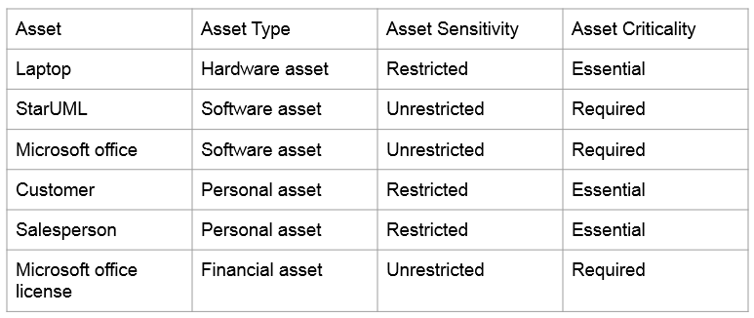
Assets

Slide 12
Vulnerabilities
Outdated software - Updating your POS system on a regular basis prevents some threats from happening. A good patch management software can automate this task.
Weak password - A strong password should at least be eight characters long. A strong password should contain alphanumeric characters. It should also contain two lowercase and two uppercase letters. It should also contain special characters. A strong password should not have any connection to you in any way.
Offline – Data cannot be transferred, sent or backed up easily as the system is offline.

Slide 13
Threads
Customer data - If the computer gets stolen, thousands of our customers’ data may have just handed over.
Password Cracking – The technique of recovering password from data that are stored in the computer.
Data lost – If the data gets lost because of user faults or system damage, the data will be lost permanently.

Slide 14
Control
Strong passwords - The use of simple passwords is one of the main weakness attackers are looking for. Unique usernames and passwords are an essential control.
Awareness - Training employees for security awareness.
Data backup – Backing up the data day by day in an external storage.

Slide 15
Management Information System
Management Information System is the term given to the discipline focused on the of computer systems with the aims and objectives on an organization.
Types of management information systems are
Management reporting
Process Control
Sales and marketing
Inventory Control
Accounting and Finance
Office Automation

Slide 16
Management Information System
Information system is the lifeblood of the organization. Manage depends upon accurate accessible and useful information, this requires the information system to be responsive to their unique information needs, to empower them to think and act and their organization’s competitiveness.

Slide 17
Components of MIS
Five primary components of system are
Hardware
Software
Data(information for decision making)
Procedures(design development and documentation)
People(individuals,groups,or organizations)

Slide 18
Structure of the System
Transaction
Salespeople are provided the facility to help them in transaction.
By doing this salespeople can save time and energy.
This information system is able to capture, store and organize all the relevant data on a regular and continuous basis.
This information system should handle customer analysis.
This information system allows the store manager flexible pricing over a financial year.

Slide 19
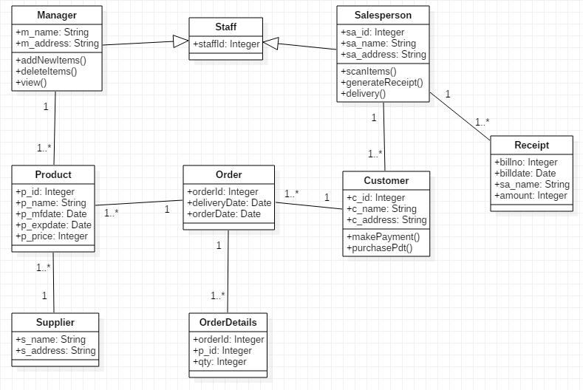
UML Diagrams
Class Diagram

Slide 20
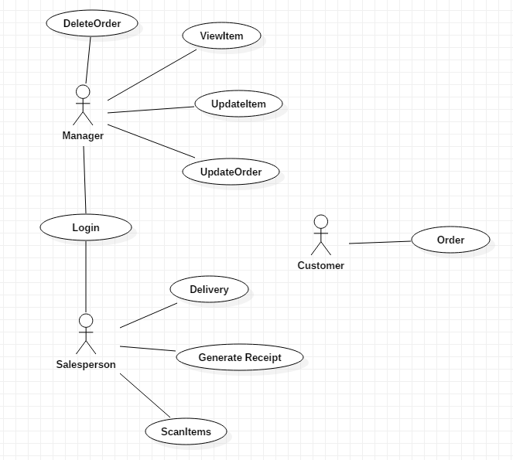
Use Case Diagram

Slide 21
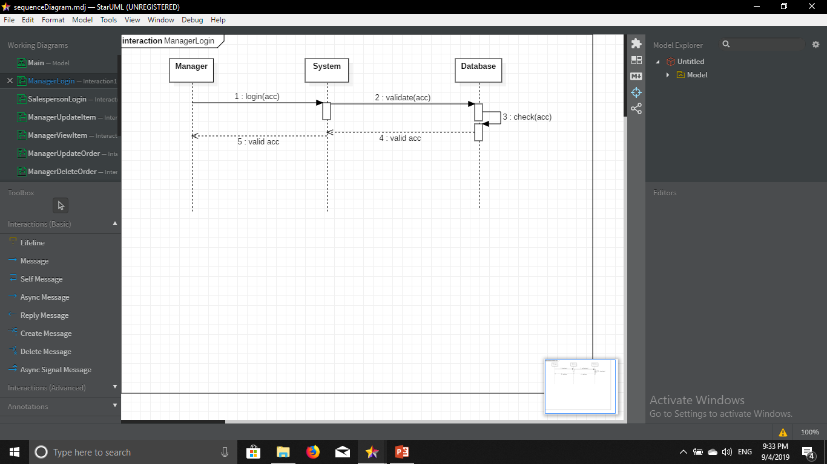
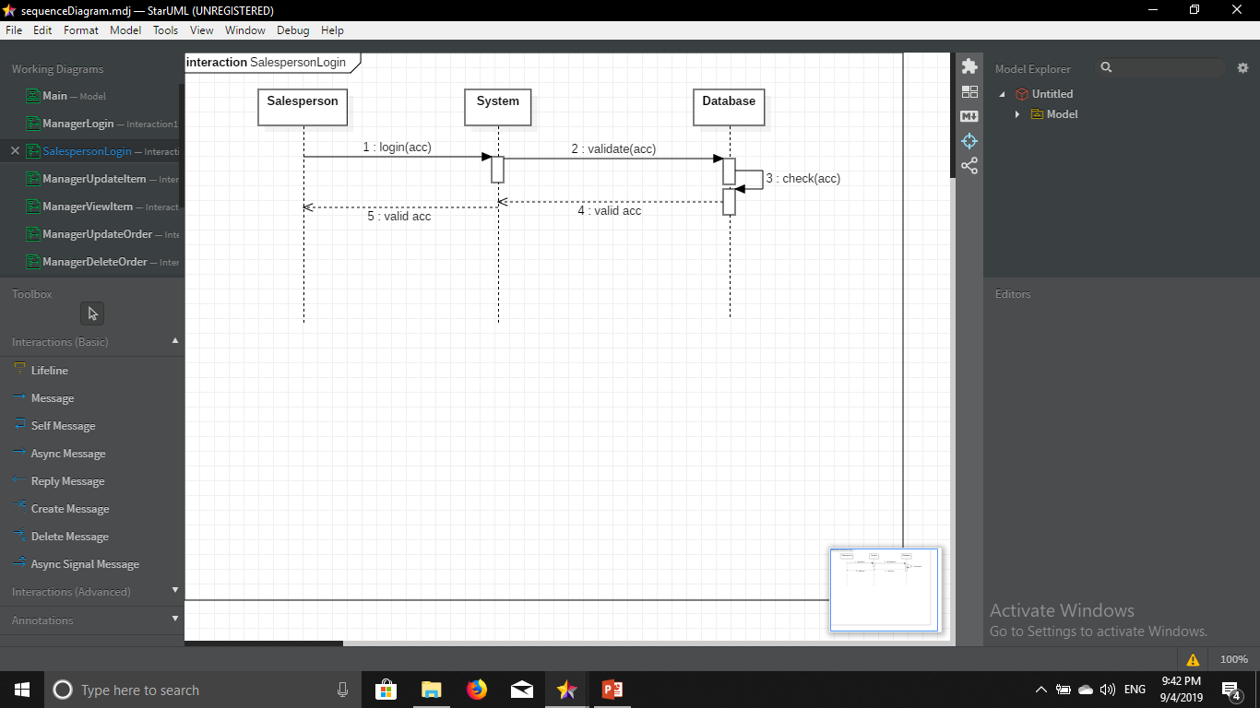
Sequence Diagrams

Slide 22
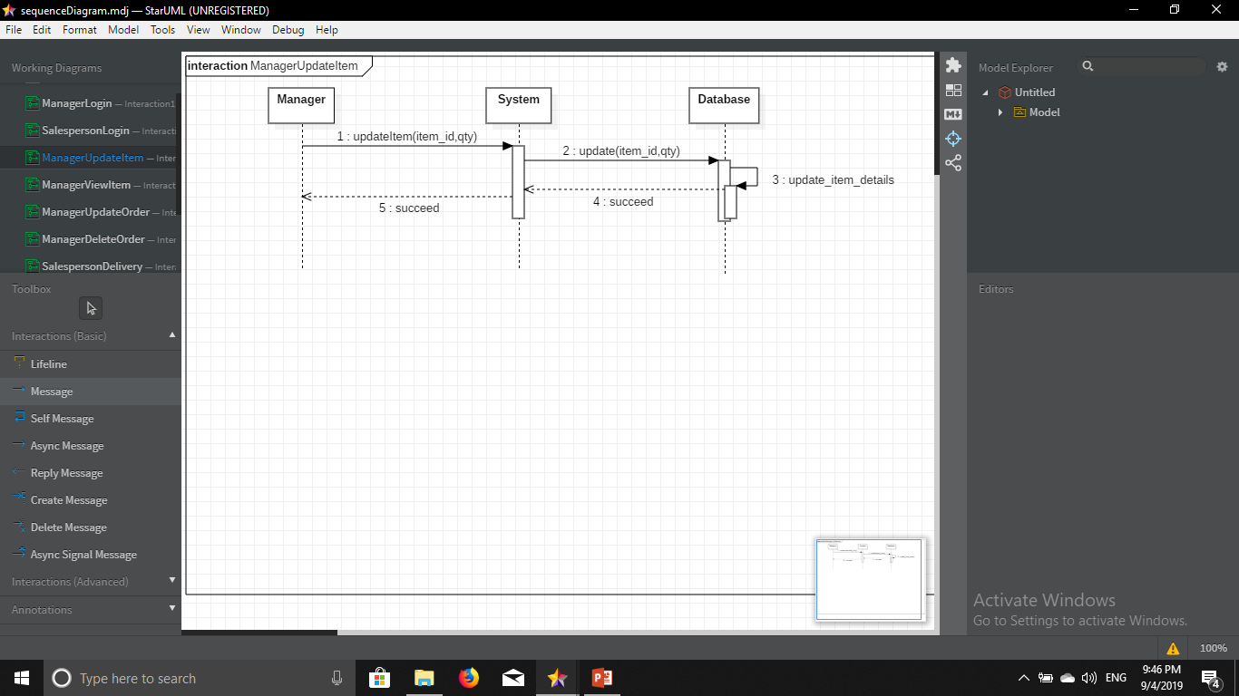
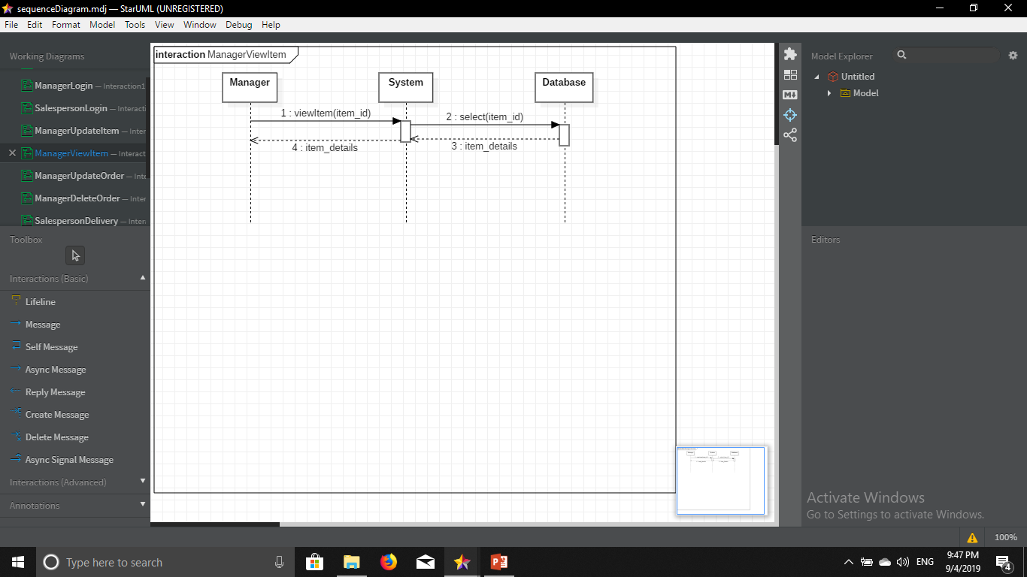
Sequence Diagrams (Cont’d)

Slide 23
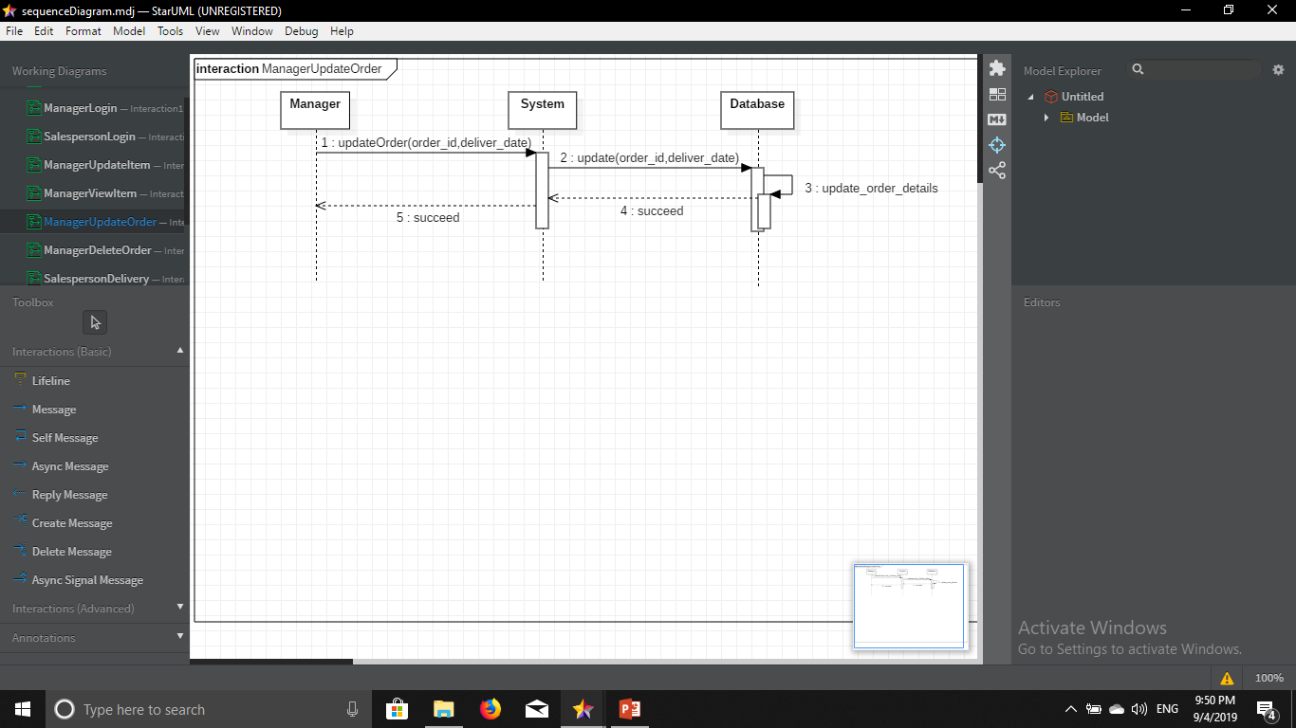

Sequence Diagrams (Cont’d)

Slide 24
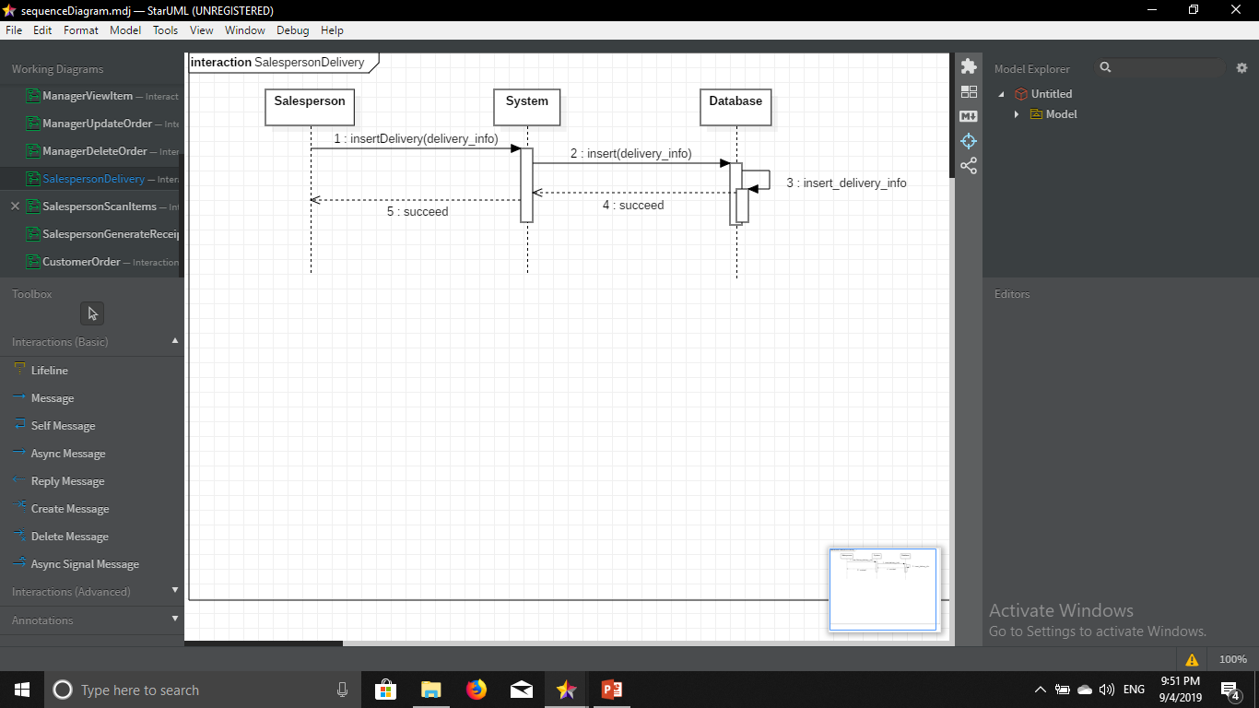
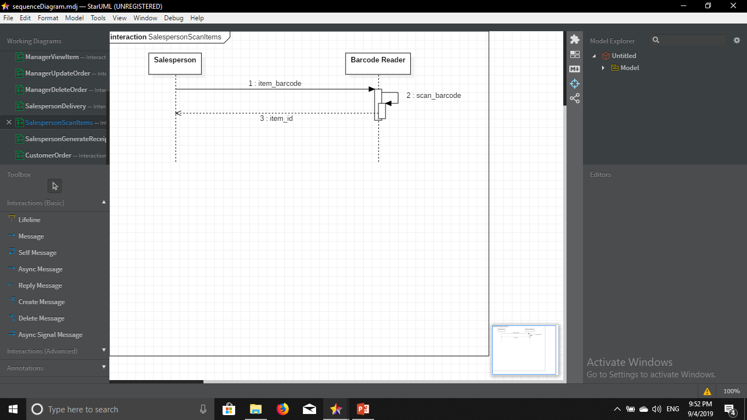
Sequence Diagrams (Cont’d)

Slide 25
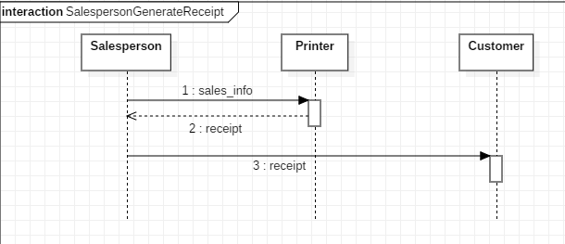
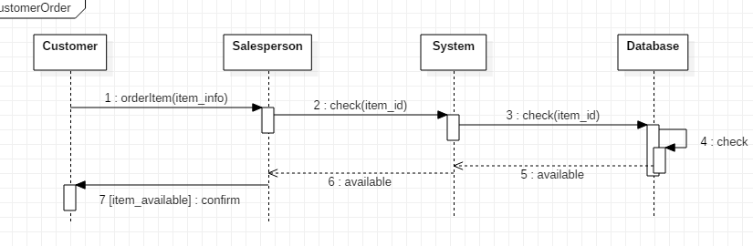
Sequence Diagrams (Cont’d)

Slide 26
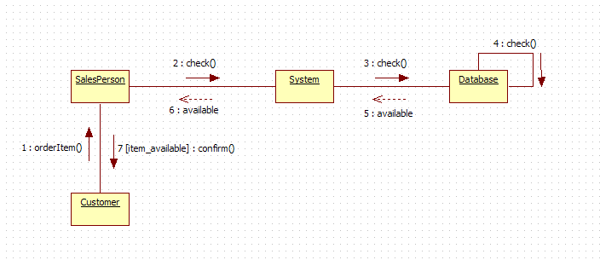
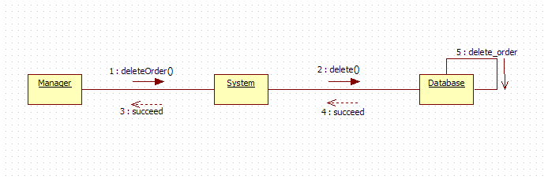
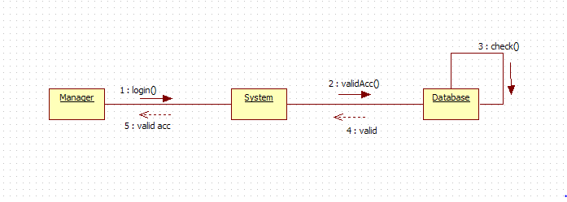
Collaboration Diagrams

Slide 27
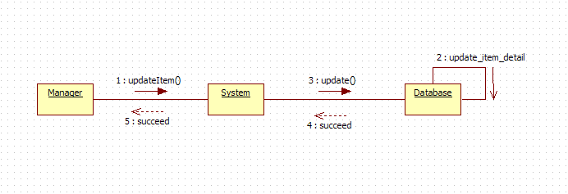
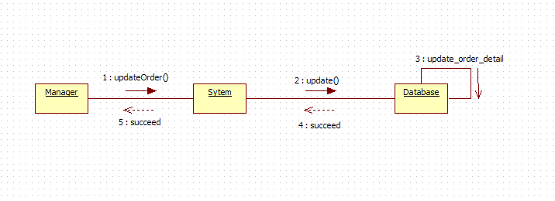
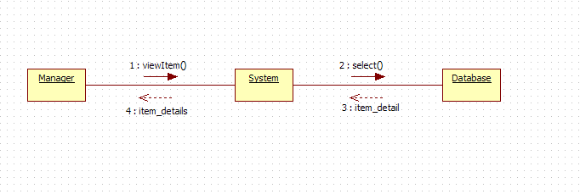
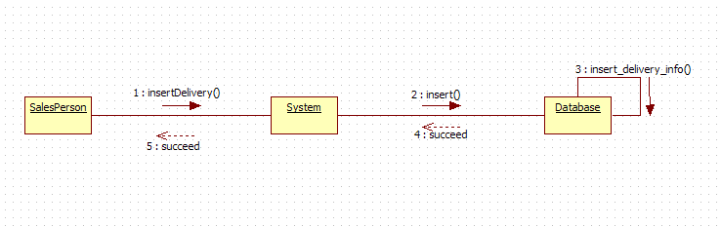
Collaboration Diagrams (Cont’d)

Slide 28
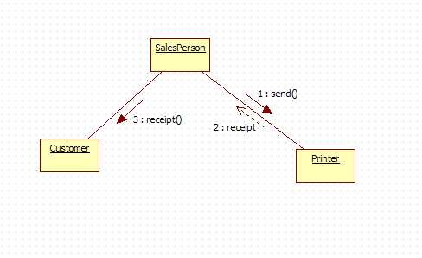
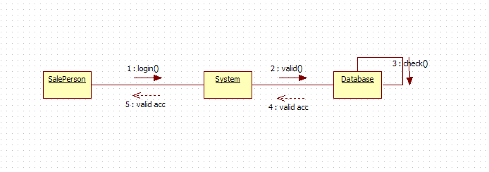
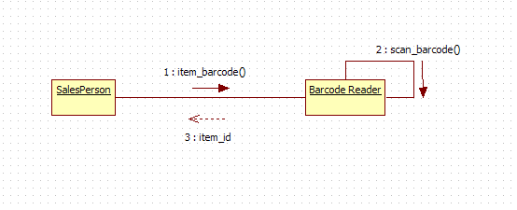
Collaboration Diagrams (Cont’d)

Slide 29
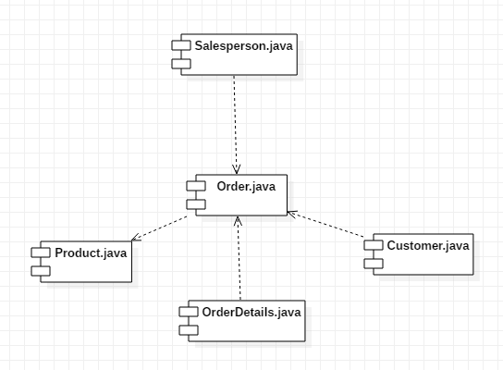
Component Diagram

Slide 30
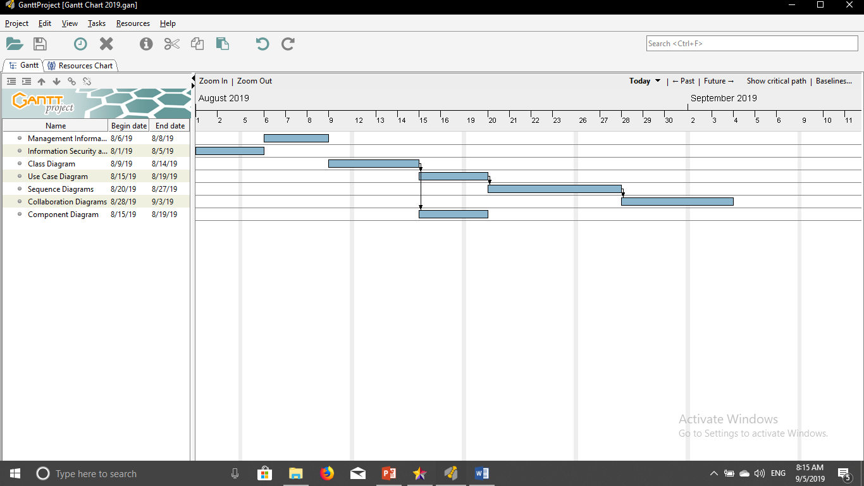
Gantt Chart

Slide 31
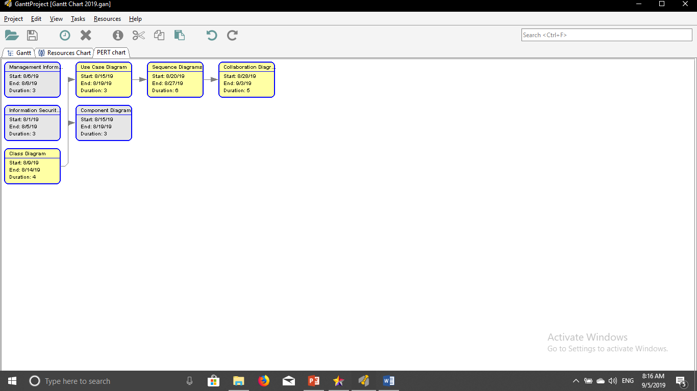
Pert Chart

Slide 32
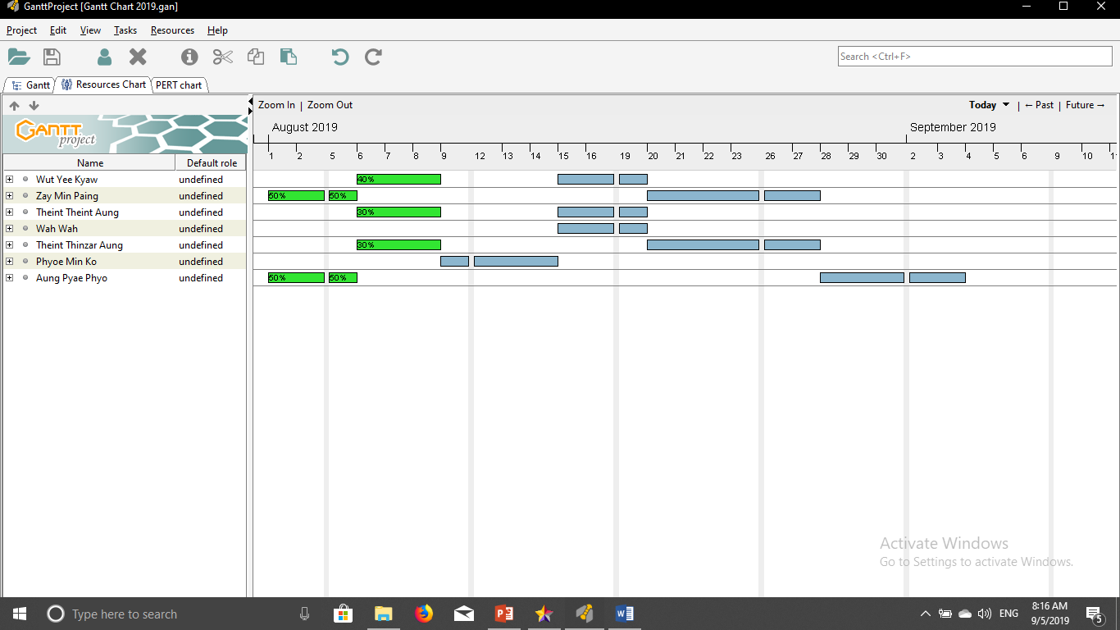
Resource Chart

Slide 33
Conclusion
This database system is for Platinum Clothing Shop in Pathein. This database system can be used in any other appropriate application like Web Applications, Java Applications, C++ Applications, C# Applications, Android Applications and so on.

